Slide 1
U.S. market index
Data Analysis
Predicting If any month can be a profitable strategy

Slide 2
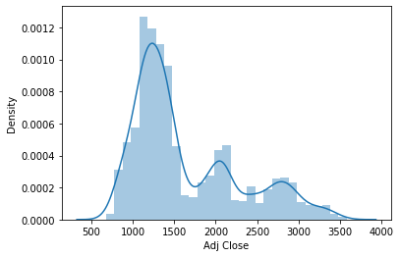
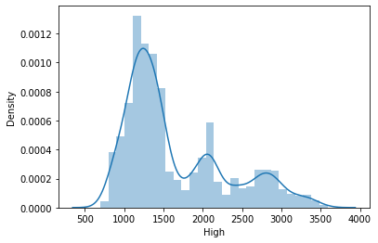
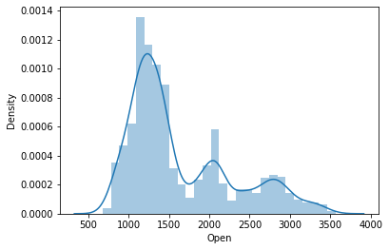
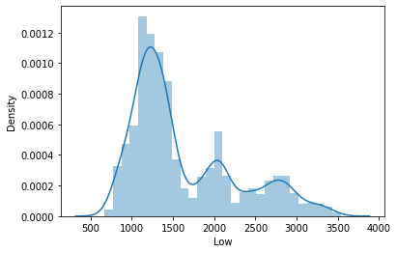
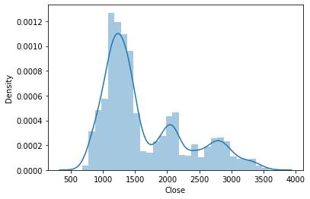
Exploratory Data Analysis
This is a Distplot for the columns Open,
Close,High,Low,and Adj Close
All These Data appears to be Dependent

Slide 3
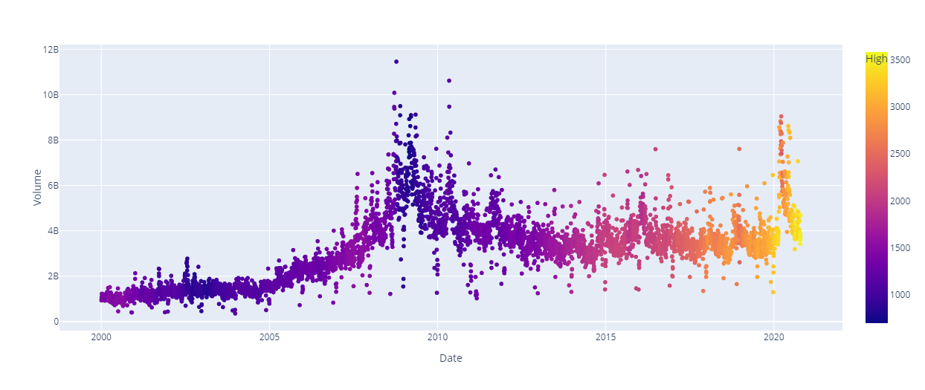
Predicting High Volume
I have used scatter plot with Date as x variable and Volume as y variable and High as the color and identified that The volume is high on the year 2008

Slide 4

Predicting Low Volume
I have used scatter plot with Date as x variable and Volume as y variable and Low as the color and identified that The volume is high on the year 2000

Slide 5
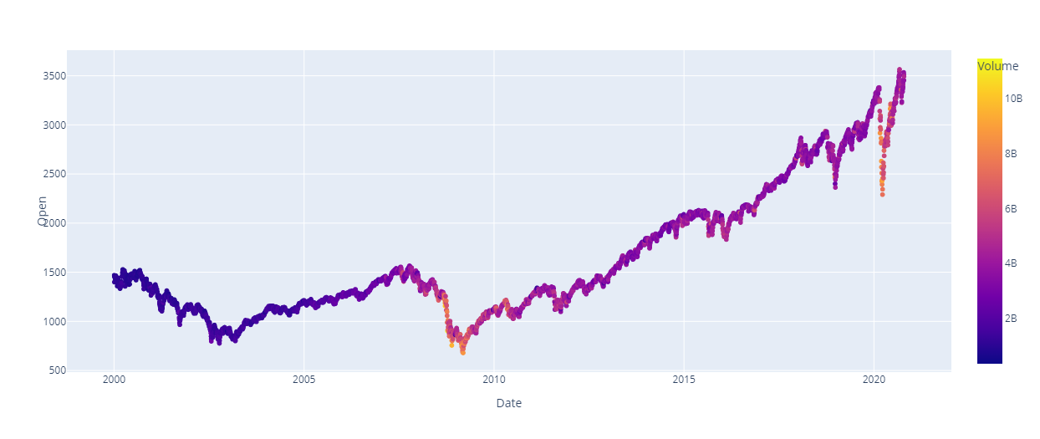
EDA Open
I have used Scatter plot with Date as x variable, Open as y variable and Volume as the color and observed that Open is Maximum at the year 2021 and minimum at the year 2009.

Slide 6

EDA Close
I have used Scatter plot with Date as x variable, Close as y variable and Volume as the color and observed that Close is Maximum at the year 2021 and minimum at the year 2009.

Slide 7

EDA Adj Close
I have used Scatter plot with Date as x variable, Adj Close as y variable and Volume as the color and observed that Adj Close is Maximum at the year 2021 and minimum at the year 2009.

Slide 8
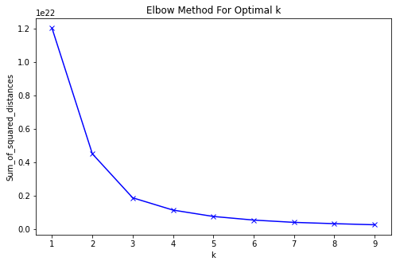
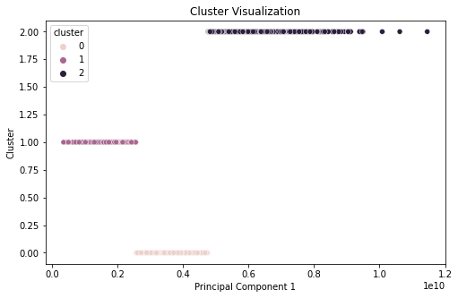
Clustering Volume Data
Based on the K means Clustering I have found out that 3 is the optimal number of clusters for daily volume data

Slide 9
Fractional Difference
I have found out the Parameters 1,2&3 based on the following formulae
Parameter_1= (Current Day Opening value/Previous Day Opening value)-1
Parameter_2= (Current Day Opening value/Current Day Closing value)-1
Parameter_3=(Current Day Volume/Previous Day Volume)-1
I have used for loop and found the Parameters for all the values of the data
I have attached the The list of values to the data

Slide 10
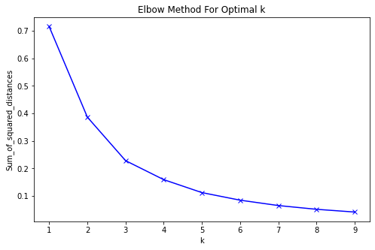
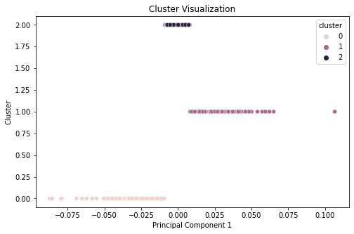
Clustering Parameter_1
Based on the K means Clustering I have found out that 3 is the optimal number of clusters for daily Parameter_1 data

Slide 11

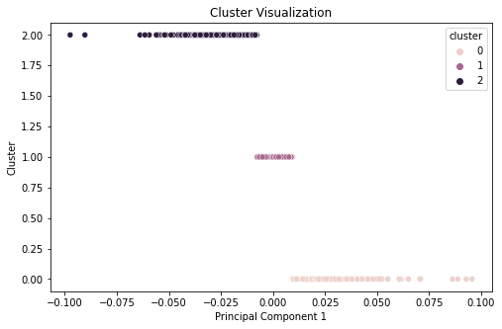
Clustering Parameter_2
Based on the K means Clustering I have found out that 3 is the optimal number of clusters for daily Parameter_2 data

Slide 12
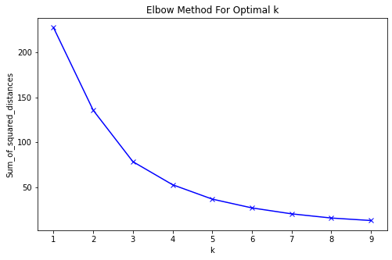
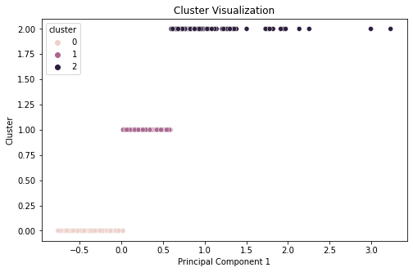
Clustering Parameter_2
Based on the K means Clustering I have found out that 3 is the optimal number of clusters for daily Parameter_2 data

Slide 13
Monthly returns
To find the Monthly returns value I first created a new data where i have grouped the data in the frequency of the month and then found the sum of the values of Open,Close and Volume.
I have used the following formula to find the Monthly returns
Monthly Returns = (Closing of the Current Month/Opening of the Current month)-1
I have used for loop and found the Monthly Returns for all Months and attached it to the data

Slide 14
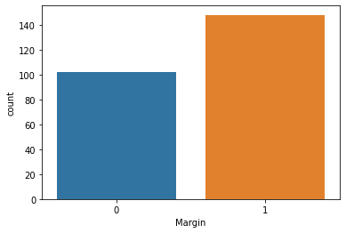
Profit and Loss margin
I have created a new column and found the profit and loss margin with the help of if condition in the Monthly returns i have used 1 for profit and 0 for loss, I have used count plot and found that In 100 months there is a loss and 150 months there is a profit.

Slide 15
Decision Tree Classifier
I have used Decision tree Classifier on the Final and predicted Whether there will be profit or loss for a particular month.
I have used Margin as the target variable.
I have used Open Close Volume and month as the features.
I have created a column called month in the final data found the month using pandas date time function.

Slide 16
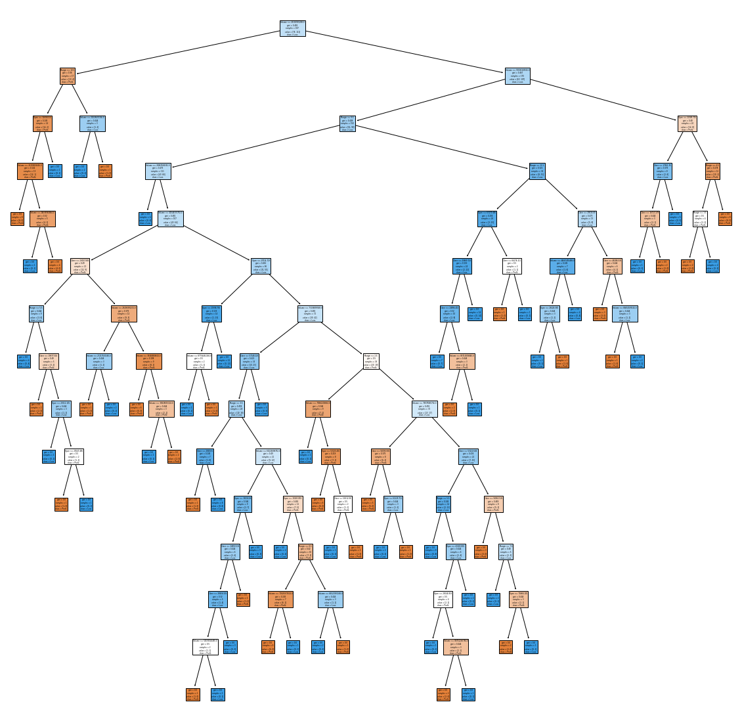
This is the Decision tree that have plotted using tree model for scikit_learn

Slide 17
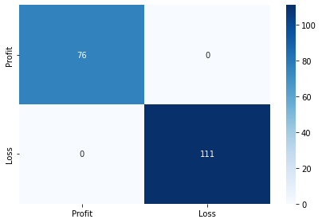
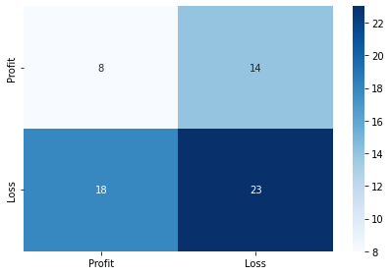
Error Metrics
I have used confusion metrics and found that my training data has a accuracy of 100% and testing data has a accuracy of 49.20% which means there is a error of 50.80%

Slide 18
GridSearch
Since my model is overfitting I have used grid searched those parameters and choosed the optimum values that gives better performance on test data.
As of now we will control these parameters
Max_depth: maximum depth of decision tree
Min_sample_split: The minimum number of samples required to split an internal node
Min_samples_leaf: The minimum number of samples required to be at a leaf node

Slide 19
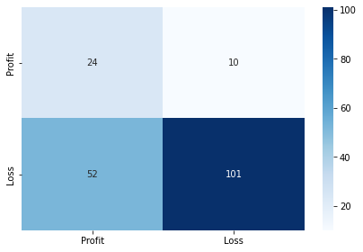
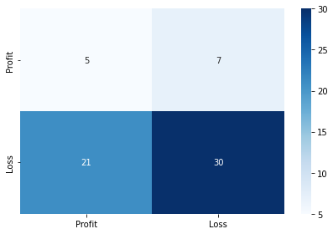
GCV Best Estimator
I have used the GCV method and found the best estimator and now my training score reduced to 66.84% and my testing score increased to 55.55%

Slide 20
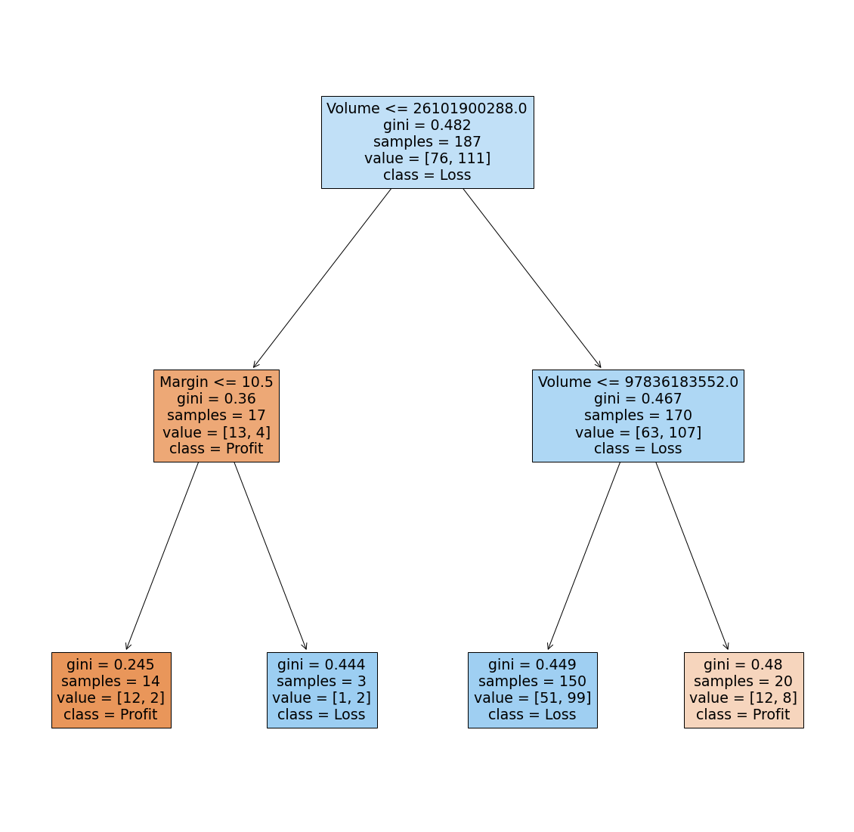
Plotting the new tree with the changed parameters

Slide 21
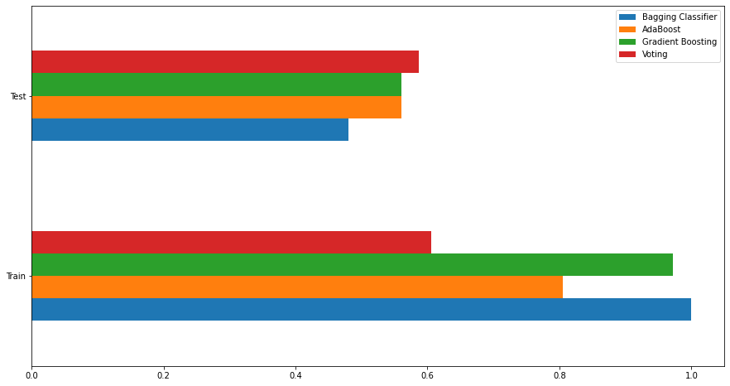
Ensemble Learning
I have used Ensemble Learning method and found that Voting classifier with SVM,Logistic regression and Decision Tree classifier produced the best scores.

Slide 22
Conclusion
In this project I have conducting Data Analysis on the U.S Market Index And Predicted if any month can be Profitable Strategy.
I have used Pandas, Numpy, Matplotlib, Seaborn, Plotly
I have used the following Machine Learning Models.
Decision Tree Classifier
Bagging Classifier
Gradient Boosting Classifier
AdaBoost Classifier &
Voting Classifier.

